Slide 1
Wyoming Counseling Association Conference Friday-October 2 (9:15-10:45 AM)
Jane Warren
Angela Garfield
University of Wyoming
Professional Studies Department

Slide 2
Who You Are Counts: How Your Are Requires Awareness
The Three Selves

Slide 3
Overview
To experience how you express your self in counseling, supervision, and relationships.
To understand how this expression impacts counselor, supervisory, and relationship competencies.
To see how a number of approaches emphasize the self in relationships.
To witness how your own self (the three selves: closed, permeable, flexible) can be integrated and/or fragmented depending upon the situation and self-awareness.
To have the tool: the three-self strategy to enhance your self-functioning as a counselor, a supervisor, and a person in relationships.

Slide 4
Outcomes
To experience the impact of self-awareness in counseling, supervision, and relationships.
To describe how your self (the three selves-closed, permeable, flexible) can be integrated and/or fragmented depending upon the situation and self-awareness.
To choose ways to relate in various interpersonal situations (counseling, supervision, relationships and work).
To identify implications and impact of self-awareness and choice on relationship competencies in counseling, supervision, relationships and work.

Slide 5
Self Awareness-Activity
Who are you? Make a list.

Slide 6
What Did You Notice?
What did you discover?
Who defines you?
How might you be different in various situations?
Who is the “self”

Slide 7
Roles

Slide 8
Actions

Slide 9
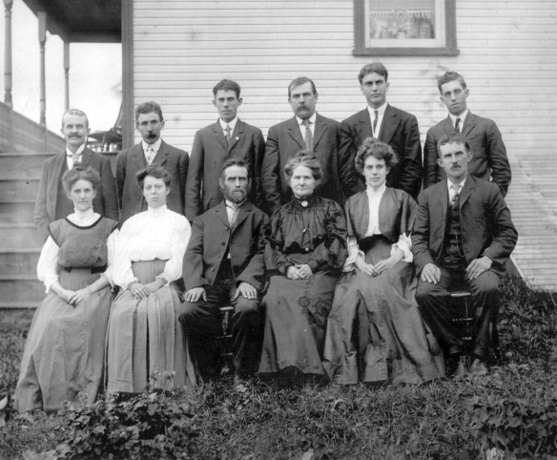
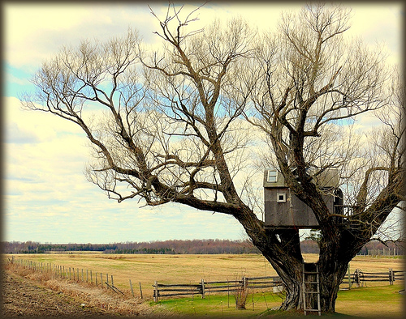
History

Slide 10
Alone

Slide 11
First Needs Met

Slide 12
How We Can Be
Closed
Permeable
Flexible

Slide 13
Closed Door

Slide 14
Permeable Door

Slide 15
Open Door

Slide 16
Activity
When are you closed (anger)?
When are you permeable (easily influenced)?
When are you flexible (open for input with boundaries to close your door)?
What is the difference for each above?

Slide 17
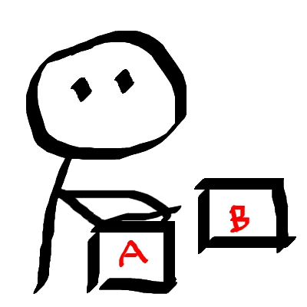
What Did You Notice?

Slide 18
As a Counselor
What is an example of when you are closed?
When are you permeable?
When are you flexible?
How does this understanding impact your work with clients?

Slide 19
As a Supervisor
What may be an example of when you are closed?
When are you permeable?
When are you flexible?
Does this change depending on supervisees?

Slide 20
Theories and the Self
Communication –Satir
Self is developed and expressed in relationships
Fives ways of interacting: congruent communicator, placater, blamer, superreasonable, and irrelevant

Slide 21
Activity
When are you
A congruent communicator,
A placater,
A blamer,
superreasonable,
irrelevant

Slide 22
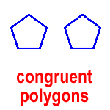
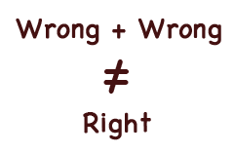
What Did You Notice?

Slide 23
Theories and the Self
Choice-Glasser
Needs for belonging, power, love, and fun often come from interactions
Success in relationships to be a function of how well the two persons get along.

Slide 24
Activity
What is choice?
When do you not have choice?

Slide 25
How We Want to Be

Slide 26
Three Selves Model
Focus:
How self-efficacy and self-awareness are recognized in the three selves.
This Three-Selves Model
can promote congruence,
is affected by situations,
can promote self-awareness and congruency, and
can influence choice and wellness in relationships such as counseling and supervision.
Questions to Ponder:
When are you closed (anger)?
When are you permeable (easily influenced)?
When are you flexible (open for input with boundaries to close your door)?
What is the difference for each above?
How might these three selves look different in various roles? As a counselor? As a supervisor?
How can you manage choice and increase awareness?
Closed
I’m ok, you are not ok
Permeable
I’m not ok, you’re ok
Flexible
I’m ok, you’re ok
Support for Model
Integrates a number of counseling approaches from Transactional Analysis, Communication, and Choice Theories.
Emphasizes self-awareness , choice, and congruence.
Jane A. Warren & Angela Garfield
University of Wyoming

Slide 27
Questions

Slide 28
Thank You

